Slide 1
云计算技术
陈果 副教授
湖南大学-信息科学与工程学院-计算机与科学系
邮箱：guochen@hnu.edu.cn
个人主页：1989chenguo.github.io

Slide 2
What we have learned
What is cloud computing
Cloud Networking
Physical Structure
Applications and network traffic
Quick overview of various typical cloud applications and their architecture
Measurement and visualization of network traffic
Implications for networking
Host networking virtualization
How host networking is virtualized
Performance problem of traditional CPU-based method
Two directions to improve
SR-IOV
Open vSwtich

Slide 3
Addressing & Routing
Part I: Cloud networking
Some materials from UIUC MOOC
Ankit Singla
ETH Zürich
P. Brighten Godfrey
UIUC
Credits to

Slide 4
Some background
From James F. Kurose and Keith W. Ross

Slide 5
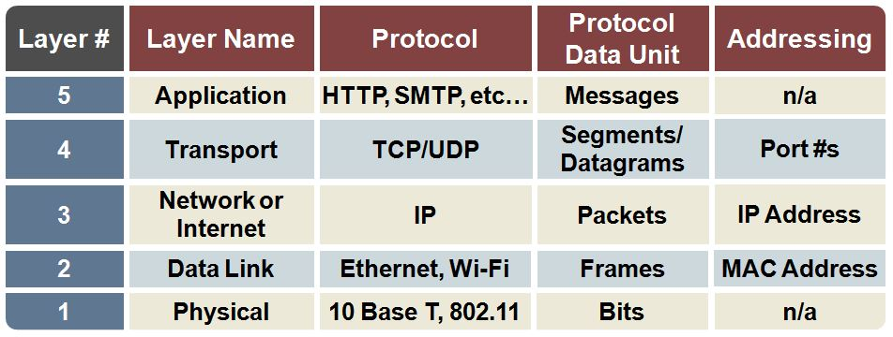
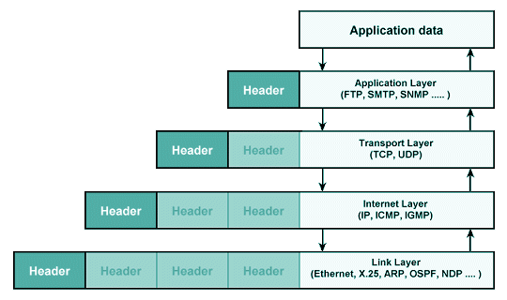
Network layer concepts

Slide 6
MAC addresses and ARP
32-bit IP address:
network-layer address for interface
used for layer 3 (network layer) forwarding
MAC (or LAN or physical or Ethernet) address:
function: used ‘locally” to get frame from one interface to another physically-connected interface (same network, in IP-addressing sense)
48 bit MAC address (for most LANs) burned in NIC ROM, also sometimes software settable
e.g.: 1A-2F-BB-76-09-AD
hexadecimal (base 16) notation
(each “number” represents 4 bits)

Slide 7

LAN addresses and ARP
each adapter on LAN has unique LAN address
1A-2F-BB-76-09-AD
LAN
(wired or
wireless)
adapter
71-65-F7-2B-08-53
58-23-D7-FA-20-B0
0C-C4-11-6F-E3-98

Slide 8
LAN addresses (more)
MAC address allocation administered by IEEE
manufacturer buys portion of MAC address space (to assure uniqueness)
analogy:
MAC address: like Social Security Number
IP address: like postal address
MAC flat address ➜ portability
can move LAN card from one LAN to another
IP hierarchical address not portable
address depends on IP subnet to which node is attached

Slide 9


ARP: address resolution protocol
Question: how to determine
interface’s MAC address, knowing its IP address?
ARP table: each IP node (host, router) on LAN has table
IP/MAC address mappings for some LAN nodes:
< IP address; MAC address; TTL>
TTL (Time To Live): time after which address mapping will be forgotten (typically 20 min)
137.196.7.78
1A-2F-BB-76-09-AD
137.196.7.23
137.196.7.14
LAN
71-65-F7-2B-08-53
58-23-D7-FA-20-B0
0C-C4-11-6F-E3-98
137.196.7.88

Slide 10
ARP protocol: same LAN
A wants to send datagram to B
B’s MAC address not in A’s ARP table.
A broadcasts ARP query packet, containing B's IP address
dest MAC address = FF-FF-FF-FF-FF-FF
all nodes on LAN receive ARP query
B receives ARP packet, replies to A with its (B's) MAC address
frame sent to A’s MAC address (unicast)
A caches (saves) IP-to-MAC address pair in its ARP table until information becomes old (times out)
soft state: information that times out (goes away) unless refreshed
ARP is “plug-and-play”:
nodes create their ARP tables without intervention from net administrator

Slide 11
Addressing: routing to another LAN
walkthrough: send datagram from A to B via R
focus on addressing – at IP (datagram) and MAC layer (frame)
assume A knows B’s IP address
assume A knows IP address of first hop router, R (how?)
assume A knows R’s MAC address (how?)
A
B
R
111.111.111.111
222.222.222.222
74-29-9C-E8-FF-55
49-BD-D2-C7-56-2A
222.222.222.220
1A-23-F9-CD-06-9B
111.111.111.112
111.111.111.110
222.222.222.221
CC-49-DE-D0-AB-7D
E6-E9-00-17-BB-4B
88-B2-2F-54-1A-0F

Slide 12
Addressing: routing to another LAN
A creates IP datagram with IP source A, destination B
A creates link-layer frame with R's MAC address as dest, frame contains A-to-B IP datagram
MAC src: 74-29-9C-E8-FF-55
MAC dest: E6-E9-00-17-BB-4B
IP
Eth
Phy
IP src: 111.111.111.111
IP dest: 222.222.222.222
A
B
R
111.111.111.111
222.222.222.222
74-29-9C-E8-FF-55
49-BD-D2-C7-56-2A
222.222.222.220
1A-23-F9-CD-06-9B
111.111.111.112
111.111.111.110
222.222.222.221
CC-49-DE-D0-AB-7D
E6-E9-00-17-BB-4B
88-B2-2F-54-1A-0F

Slide 13
Addressing: routing to another LAN
frame sent from A to R
frame received at R, datagram removed, passed up to IP
MAC src: 74-29-9C-E8-FF-55
MAC dest: E6-E9-00-17-BB-4B
IP src: 111.111.111.111
IP dest: 222.222.222.222
IP
Eth
Phy
IP src: 111.111.111.111
IP dest: 222.222.222.222
IP
Eth
Phy
A
B
R
111.111.111.111
222.222.222.222
74-29-9C-E8-FF-55
49-BD-D2-C7-56-2A
222.222.222.220
1A-23-F9-CD-06-9B
111.111.111.112
111.111.111.110
222.222.222.221
CC-49-DE-D0-AB-7D
E6-E9-00-17-BB-4B
88-B2-2F-54-1A-0F

Slide 14
Addressing: routing to another LAN
R forwards datagram with IP source A, destination B
R creates link-layer frame with B's MAC address as dest, frame contains A-to-B IP datagram
MAC src: 1A-23-F9-CD-06-9B
MAC dest: 49-BD-D2-C7-56-2A
IP
Eth
Phy
IP
Eth
Phy
IP src: 111.111.111.111
IP dest: 222.222.222.222
A
B
R
111.111.111.111
222.222.222.222
74-29-9C-E8-FF-55
49-BD-D2-C7-56-2A
222.222.222.220
1A-23-F9-CD-06-9B
111.111.111.112
111.111.111.110
222.222.222.221
CC-49-DE-D0-AB-7D
E6-E9-00-17-BB-4B
88-B2-2F-54-1A-0F

Slide 15
Addressing: routing to another LAN
R forwards datagram with IP source A, destination B
R creates link-layer frame with B's MAC address as dest, frame contains A-to-B IP datagram
MAC src: 1A-23-F9-CD-06-9B
MAC dest: 49-BD-D2-C7-56-2A
IP
Eth
Phy
IP
Eth
Phy
IP src: 111.111.111.111
IP dest: 222.222.222.222
A
B
R
111.111.111.111
222.222.222.222
74-29-9C-E8-FF-55
49-BD-D2-C7-56-2A
222.222.222.220
1A-23-F9-CD-06-9B
111.111.111.112
111.111.111.110
222.222.222.221
CC-49-DE-D0-AB-7D
E6-E9-00-17-BB-4B
88-B2-2F-54-1A-0F

Slide 16
Addressing: routing to another LAN
R forwards datagram with IP source A, destination B
R creates link-layer frame with B's MAC address as dest, frame contains A-to-B IP datagram
MAC src: 1A-23-F9-CD-06-9B
MAC dest: 49-BD-D2-C7-56-2A
IP src: 111.111.111.111
IP dest: 222.222.222.222
IP
Eth
Phy
A
B
R
111.111.111.111
222.222.222.222
74-29-9C-E8-FF-55
49-BD-D2-C7-56-2A
222.222.222.220
1A-23-F9-CD-06-9B
111.111.111.112
111.111.111.110
222.222.222.221
CC-49-DE-D0-AB-7D
E6-E9-00-17-BB-4B
88-B2-2F-54-1A-0F

Slide 17

Switch: multiple simultaneous transmissions
hosts have dedicated, direct connection to switch
switches buffer packets
Ethernet protocol used on each incoming link, but no collisions; full duplex
each link is its own collision domain
switching: A-to-A’ and B-to-B’ can transmit simultaneously, without collisions
A
C’
B
6
1
2
5
4
3
B’
C
A’
switch with six interfaces
(1,2,3,4,5,6)

Slide 18
Switch forwarding table
Q: how does switch know A’ reachable via interface 4, B’ reachable via interface 5?
A
C’
B
A: each switch has a switch table, each entry:
(MAC address of host, interface to reach host, time stamp)
looks like a routing table!
6
1
2
5
4
3
B’
C
A’
Q: how are entries created, maintained in switch table?
something like a routing protocol?
switch with six interfaces
(1,2,3,4,5,6)

Slide 19
Switch: self-learning
Source: A
Dest: A’
switch learns which hosts can be reached through which interfaces
when frame received, switch “learns” location of sender: incoming LAN segment
records sender/location pair in switch table
A
A A’
C’
B
6
1
2
5
4
3
B’
C
A’
MAC addr interface TTL
A
1
60
Switch table
(initially empty)

Slide 20
Switch: frame filtering/forwarding
when frame received at switch:
1. record incoming link, MAC address of sending host
2. index switch table using MAC destination address
3. if entry found for destination then {
if destination on segment from which frame arrived then drop frame
else forward frame on interface indicated by entry
}
else flood /* forward on all interfaces except arriving
interface */

Slide 21
Self-learning, forwarding: example
Source: A
Dest: A’
A
A A’
frame destination, A’, locaton unknown:
flood
C’
B
destination A location known:
6
1
2
A A’
A A’
A A’
A A’
selectively send
on just one link
A A’
5
4
3
B’
C
A’ A
A’
MAC addr interface TTL
A
1
60
switch table
(initially empty)
A’
4
60

Slide 22

Interconnecting switches
switches can be connected together
S₄
S₁
S₃
A
S₂
F
I
B
C
D
E
G
H
Q: sending from A to G - how does S₁ know to forward frame destined to F via S₄ and S₃?
A: self learning! (works exactly the same as in single-switch case!)

Slide 23
Institutional network
mail server
to external
network
router
web server
IP subnet

Slide 24
Two key network-layer functions
forwarding: move packets from router’s input to appropriate router output
routing: determine route taken by packets from source to dest.
routing algorithms
analogy:
routing: process of planning trip from source to dest
forwarding: process of getting through single interchange

Slide 25
Now let’s begin!

Slide 26
Goal: find paths through the network
Switch
Server-rack
How do I reach the destination server?
Notes:
Routing: finding paths through the network

Slide 27
Plug-and-play at Layer 2
Switch
Send to a.b.c.d!
(ARP) a.b.c.d = A::B::C::D::E::F
Server-rack
Notes:
Routing: finding paths through the network

Slide 28
Loop-freedom in forwarding
Notes:
Loop prevention is essential!

Slide 29

Radia Perlman: Inventor of STP
I think that I shall never see
A graph more lovely than a tree.
A tree whose crucial property
Is loop-free connectivity.
[Excerpt from “Algorhyme” by Radia Perlman]
Notes:
Invented by Radia Perlman in 1980s
Public domain image: https://commons.wikimedia.org/wiki/File:Radia_Perlman_2009.jpg

Slide 30
Spanning tree
Disable all other links!
Notes:
Traditional approach: spanning tree protocol
core idea: create a tree (animate)
(other links = brought up on failure)
Before criticism: it was a VERY important development!!
plug and play; works over Ethernet, simple
Also: still being used!

Slide 31
STP works for tree-like networks
Notes:
STP works for tree-like networks
Take this example

Slide 32
STP works for tree-like networks
Notes:
essentially, tree + redundancy
BUT expensive to scale (as we’ve discussed earlier)
root switches are made bigger for the cross-traffic, etc.

Slide 33
STP works for tree-like networks
But ☹ :
loose network capacity
Sensitive to failure
Notes:
As we saw in … topology etc. etc.
Networks are scaling horizontally
STP is a bad fit here
many links left unused
can’t do multi-pathing (TE, fault tolerance in cloud)
extremely fragile: partitions, broadcast storms
traffic volume through root
slow convergence, seconds!

Slide 34
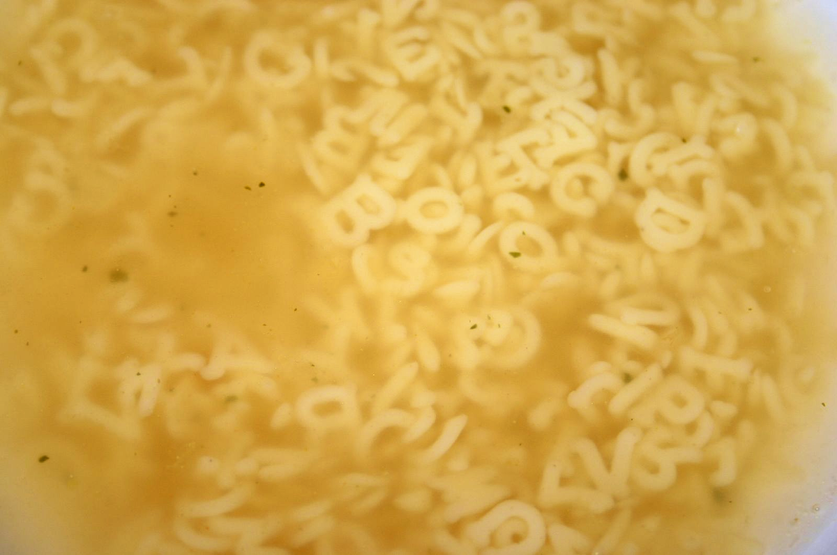
FabricPath
M-LAG
TRILL
QFabric
SPB
VCS
Image adapted from “Buchstabensuppe” by Till Westermayer
Notes:
An alphabet soup of proposed fixes:
- Hard to assess which (if any!) is “winning”
- Proprietary flavors of standards only add to confusion!
- e.g. TRILL ——> Brocade’s VCS and Cisco’s FabricPath
Debate among operators (e.g. at Nanog)
(https://www.nanog.org/meetings/nanog50/presentations/Monday/NANOG50.Talk63.NANOG50_TRILL-SPB-Debate-Roisman.pdf)
Image: create commons: https://commons.wikimedia.org/wiki/File:Buchstabensuppe.jpg

Slide 35
Transparent Interconnection of Lots of Links
Link-state protocol between switches
Notes:
Let’s (briefly) look at TRILL
Not that it’s the best (still being argued) — just to illustrate one possibility
Link-state protocol between switches (or as trill calls them RBridges)
Learn which hosts are where either from data packets OR announcements OR a directory

Slide 36
TRILL
All links usable!
Notes:
All links are usable
Multi-path routing is available

Slide 37
TRILL
But ☹ :
Scalability
Data-center-scale link-state incurs too much overhead
Data-center-scale flat addressing and routing
Tricky to handle ARP flood
Need hardware change
Notes:
Host sends packet to ingress RBridge
RBridge encapsulates it for transit through to destination RBridge
Nevertheless:
relies on flooding of information
~ADDRESS LEARNING
○ From Locally Received Native Frames; From Decapsulated Native Frames
○ Via Optional End Station Address Distribution Information protocol
○ Via Layer-2 Registration protocol(s)
○ By manual configuration
single failure domain
requires new equipment that supports it
still concerns about relative “newness” / maturity —> operators are conservative!!

Slide 38
Scale
Scale
Scale
Scale
Scale
Scale
Scale
Notes:
What’s the problem specifically?
- Unmanageable ARP traffic!
- Routing table size

Slide 39
Traditional solution: subnets
10.2.*
10.2.4.*
10.2.3.*
Notes:
How would you solve this problem?! You can break the network down into subnets:
subnets scale routing tables by aggregation

Slide 40
Traditional solution: VLANs
10.2.*
10.2.4.*
10.2.3.*
Notes:
You can break the network down into VLANs
VLANs restrict ARP traffic
What problems does that cause?!!
migrating VM breaks aggregation OR requires change of IP address
management of subnets — size them appropriately, configuration, etc.
Limited size of VLANs because of ARP problems
resource fragmentation; how to use different resources in different subnets and VLANs together? Quickly becomes a management nightmare.

Slide 41
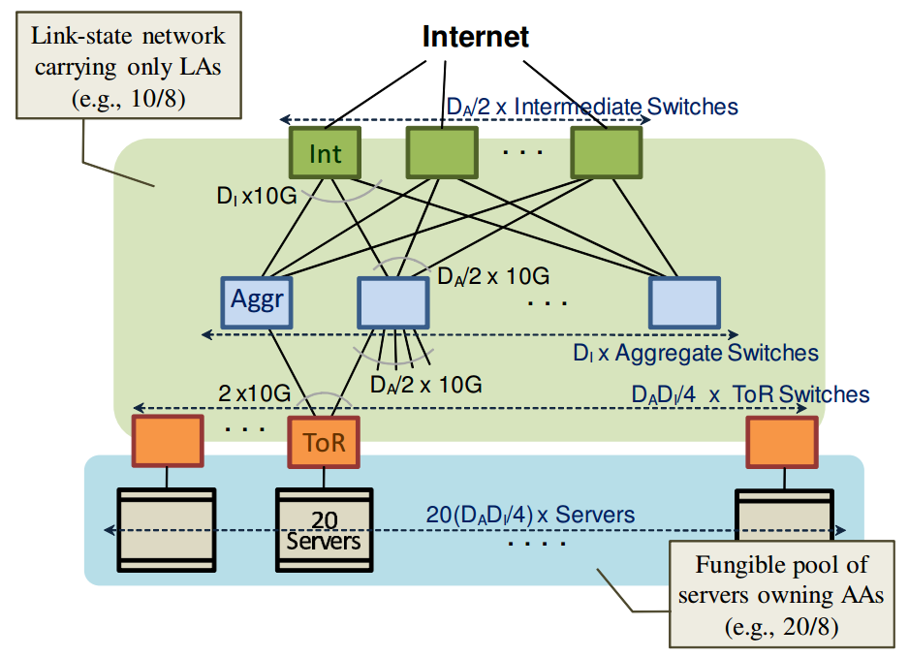
VL2: “Virtual Layer 2”
VL2 @ Microsoft, ACM SIGCOMM’09
Greenburg, Hamilton, Jain, Kandula, Kim, Lahiri, Maltz, Patel, Sengupta

Slide 42
VL2: “Virtual Layer 2”
Clos network
Name ≠ Location
Randomized load balancing
VL2 @ Microsoft, ACM SIGCOMM’09
Greenburg, Hamilton, Jain, Kandula, Kim, Lahiri, Maltz, Patel, Sengupta
Notes:
We’ll only talk about the name translation part here, leaving load balancing for later. Quiz question: why did VL2 use its own load balancing instead of ECMP?! Note: the motivating factors might have disappeared over time.

Slide 43
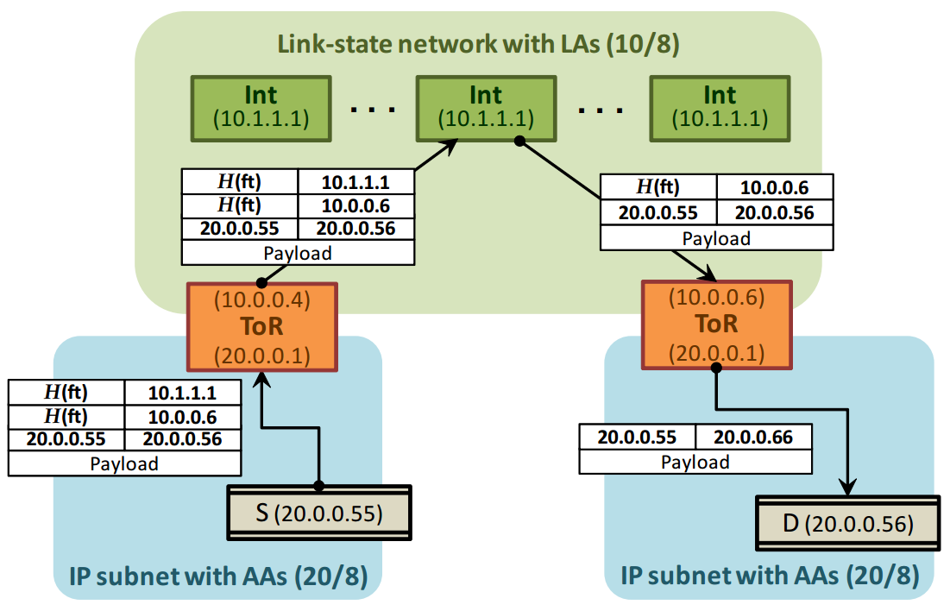
VL2: Location vs. App addresses
Virtual IP: Name
Unique
Physical IP: Location
Routing friendly
Physical IP
Virtual IP
VL2 @ Microsoft, ACM SIGCOMM’09
Greenburg, Hamilton, Jain, Kandula, Kim, Lahiri, Maltz, Patel, Sengupta
Notes:
Capture packets at host agent, encap with dest. host ToR
Requires this modification at the end-host

Slide 44
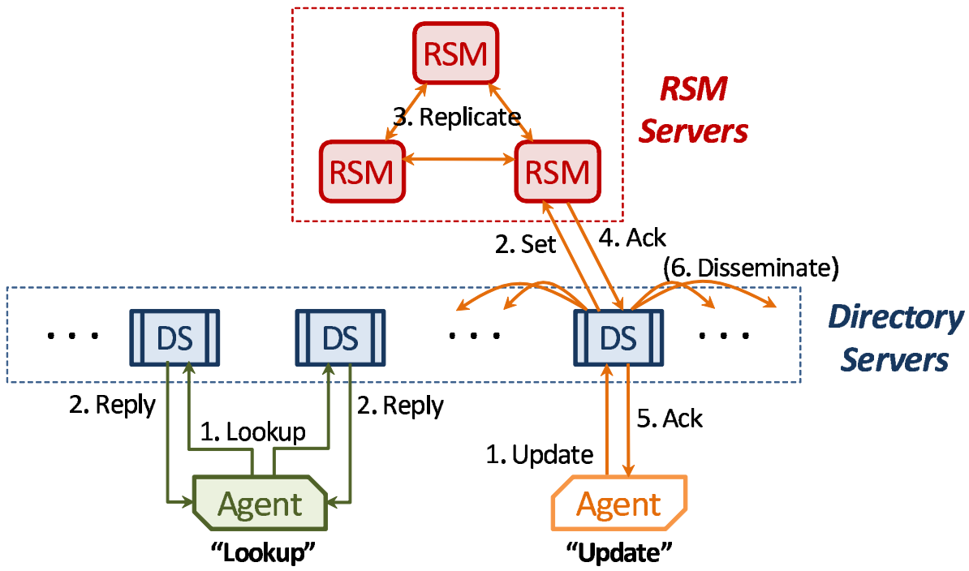
VL2: Address translation
VL2 @ Microsoft, ACM SIGCOMM’09
Greenburg, Hamilton, Jain, Kandula, Kim, Lahiri, Maltz, Patel, Sengupta
Notes:
Address translation infra
agents at hosts for capturing ARPs
read optimized dir servers
write opt RSMs
query multiple directory servers for quick response
how stale caches at hosts are corrected? Reactively. Packets arrive at the wrong ToR, which communicates with dir servers, which send a correction to the source …

Slide 45
VL2: Location vs. App addresses
VL2 @ Microsoft, ACM SIGCOMM’09
Greenburg, Hamilton, Jain, Kandula, Kim, Lahiri, Maltz, Patel, Sengupta
Notes:
Capture packets at host agent, encap with dest. host ToR
Requires this modification at the end-host

Slide 46
Routing algorithm classification
Q: global or decentralized information?
global:
all routers have complete topology, link cost info
“link state” algorithms
decentralized:
router knows physically-connected neighbors, link costs to neighbors
iterative process of computation, exchange of info with neighbors
“distance vector” algorithms

Slide 47
OSPF over IP
I know the
entire topology!
Notes:
OSPF is a very mature routing technology
OSPF over IP conveniently sidesteps many STP problems
Simple implementation: link state protocol all-over network
Link-state scalability and single-failure domain issues persist
[Although route summarization and stub-areas help]
TE limited to meddling with link costs
Another option: L2 areas connected over OSPF —> higher complexity

Slide 48
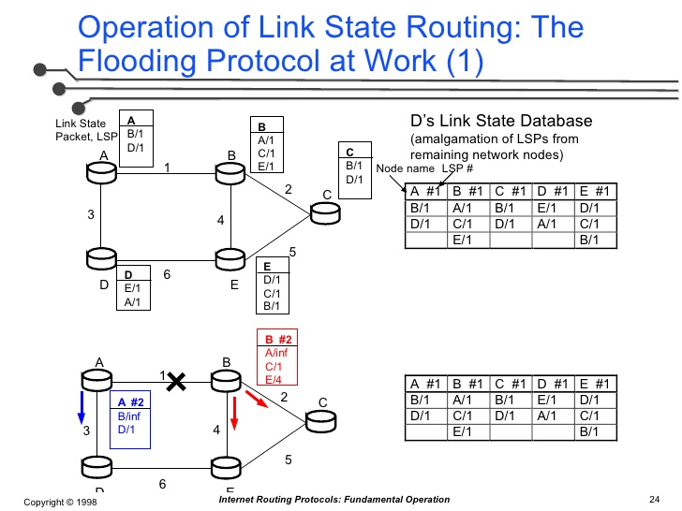
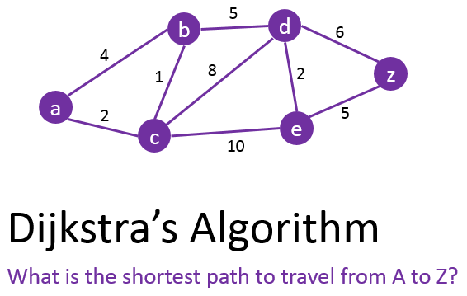
Link-state Routing
Still encounter scalability issue for super-large cloud

Slide 49
BGP: Border Gateway Protocol
AS5
AS4
AS1
AS2
23.18.98.*
AS3
Notes:
Another design option: BGP … yes. And not I-BGP!
Let’s review (skipping many details relevant to BGP on Internet) …
(Do the review)

Slide 50
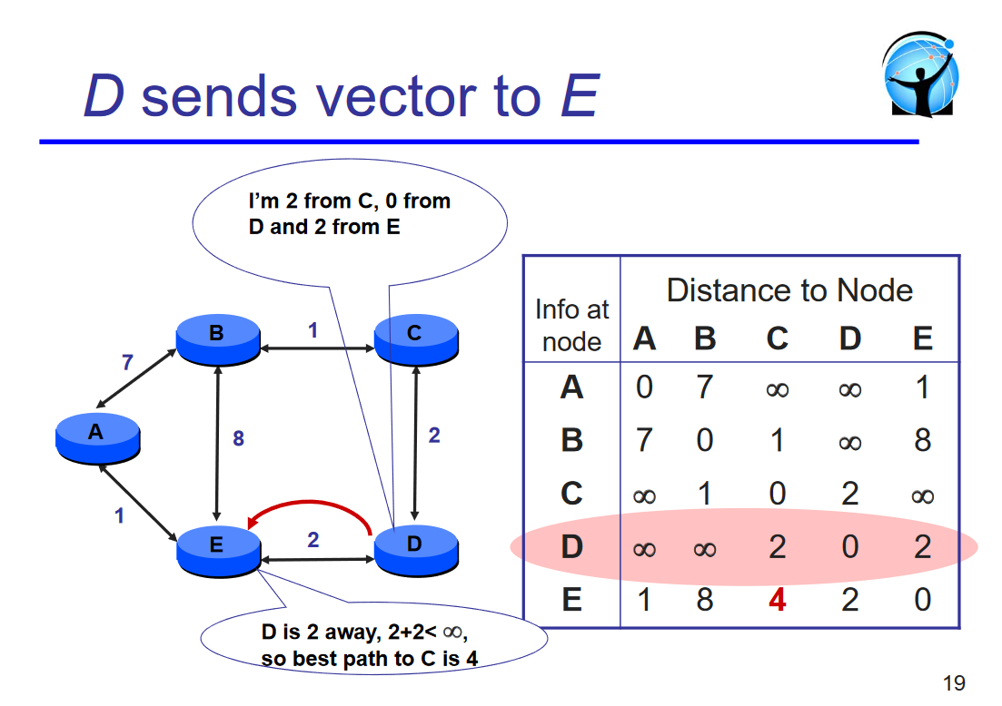
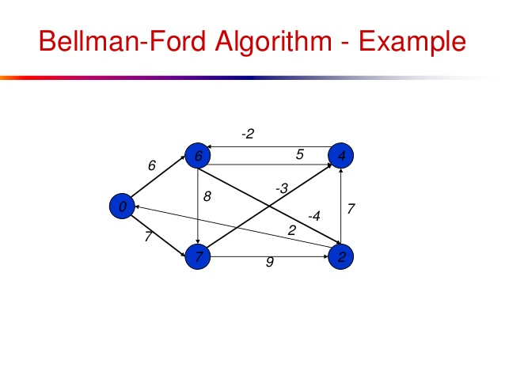
Distance-vector Routing
More scalable and flexible!

Slide 51

BGP: Border Gateway Protocol
23.18.98.* | AS5 AS1
AS5
AS4
23.18.98.* | AS1
23.18.98.* | AS5 AS1
AS1
23.18.98.* | AS2 AS1
AS2
I already know a shorter path!
23.18.98.* | AS1
23.18.98.* | AS2 AS1
23.18.98.*
AS3
Notes:
Another design option: BGP … yes. And not I-BGP!
Let’s review (skipping many details relevant to BGP on Internet) …
(Do the review)

Slide 52
BGP in the data center
AS 64999
AS 65111
AS 64981
Divide groups of switches and servers into Ases;
Use BGP!
AS 65000
AS 65001
AS 65002
AS 65003
Notes:
Facebook has mentioned using BGP, doesn’t use server virtualization
IP aggregation makes routing tables small
No more L2 scalability concerns (no message flooding)
BGP is well-tested
multi-path w ECMP (more details later)
vs OSFP:
Easier debugging (AS_PATH is visible)
Inter-operability across vendors is greater than OSPF
Every link failure in OSPF => flood. Not here.
Per-hop traffic engineering (can announce arbitrary subset of routes)
Cons:
VM migration is more complex
slow convergence (although route changes are infrequent)
complexity? (auto-gen of configs)
Route manipulations may also be done via central coordination (SDN)!!

Slide 53
Routing
Notes:
So far: routing, i.e., figuring out a set of paths
Now, how to use these paths?
Besides connectivity, we want
fault tolerance
efficient traffic engineering
These are things multipath routing helps with …

Slide 54
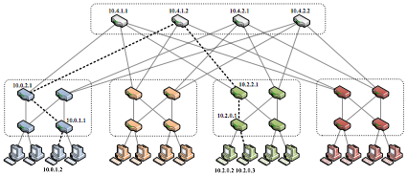

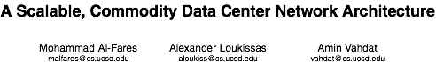
Multipath routing
Notes:
The example we’ll work with …
The fat-tree topology
has lots of parallel paths
can we exploit them for fault tolerance and TE?
TE goal: want to minimize congestion
Difficult problem!
traffic is dynamic
computationally expensive even when centralized
distributed algorithm needed
Approximation: randomized spreading of traffic with ECMP
Image: from the fat-tree paper here: http://ccr.sigcomm.org/online/files/p63-alfares.pdf

Slide 55
Equal cost multi-path (ECMP)
10.2.0.3 | port 1
10.2.0.3 | port 2
Choose uniformly
at random!
Notes:
Let’s see how ECMP works.
To send traffic from one of these nodes to the other …
forward packet to switch
now, two choices (known from routing protocol) (animate)
routing table entries might look something like this (animate)
pick one uniformly at random!

Slide 56

Equal cost multi-path (ECMP)
10.2.0.3 | port 1
10.2.0.3 | port 2
Choose uniformly
at random!
Notes:
BUT … packet spraying is problematic for TCP

Slide 57
Equal cost multi-path (ECMP)
1
2
Output port = hash (packet header)
Notes:
(Walk through example)
Explain solution: flow-level hashing

Slide 58
Equal cost multi-path (ECMP)
Notes:
ECMP can be done independently at each hop!
Number of paths increases multiplicatively
So 2 X 2 = 4 path choices here

Slide 59
Equal cost multi-path (ECMP)
Notes:
ECMP is simple
Works over both L2 and L3 routing
Works quite well for large number of small flows
The use of a random hashing to map flows to outgoing ports works particularly well if most flows are short.
Sophisticated operators (e.g. Facebook):
controller monitors imbalances, fixes paths if necessary
Source of information FB talk (https://youtu.be/kcI3fGEait0?t=1033)

Slide 60
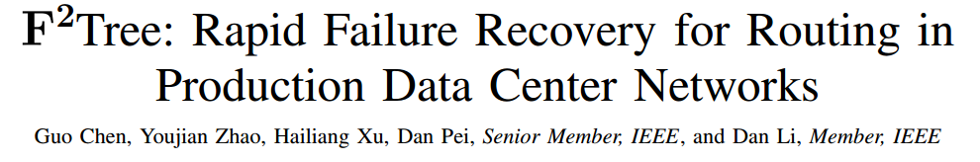
ECMP: local, oblivious choices
IEEE/ACM Transactions on Networking, 2017
x
Cannot avoid distant failures!
Notes:
A more serious issue, perhaps, is that ECMP only makes local decisions, without knowledge of failures further on a path. If some later link is down, ECMP, making only these local choices can do nothing to avoid it. (Note how in this topology, there is another failure-free path available, while from the node which first sees the failure on this path, there are no paths.)

Slide 61
ECMP: traffic imbalance
Output port = hash (packet header)
Notes:
But the randomization will sometimes lead to imbalance in flow assignments. This can cause long-lasting congestion if multiple long-lasting data flows are mapped onto the same links. As we noted earlier, we can’t do randomization at packet level, because that causes packet re-ordering. However, we don’t necessarily have to do it at flow-level either. This is where the idea of a “flowlet” is useful.

Slide 62
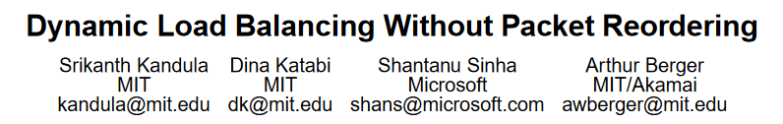



Flowlets
ACM SIGCOMM, 2007
>𝝙l
>𝝙l
Flowlets
Notes:
If the gap between groups of packets is larger than a conservative estimate of the latency difference between the paths, we can send them on different paths without risk of reordering.
Such packet groups are called flowlets.
This helps make load balancing more fine-grained, and unlikely to run into long-term congestion problems caused by random choices.
This idea was proposed by Kandula et al. in 2007.

Slide 63
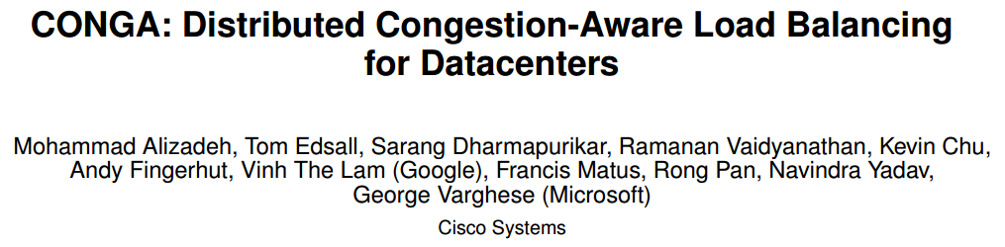
CONGA: edge based monitoring
ACM SIGCOMM, 2014
Notes:
Recent work proposes a solution to this problem: the key idea is to monitor congestion on paths in real-time, and pick the least congested path (on a flowlet granularity)

Slide 64


Design: Leaf-to-Leaf Feedback
Track path-wise congestion metrics (3 bits) between each pair of leaf switches
Rate Measurement Module
measures link utilization
L0➔L2
Path=2
CE=0
L0➔L2
Path=2
CE=5
pkt.CE ⬅ max(pkt.CE, link.util)
Path
Path
3
3
2
0
1
2
0
1
Dest Leaf
2
Src Leaf
5
3
7
5
L1
L0
1
1
5
4
L2
L1
Congestion-To-Leaf
Table @L0
Congestion-From-Leaf
Table @L2
L0➔L2
Path=2
CE=0
L2➔L0
FB-Path=2
FB-Metric=5
L0➔L2
Path=2
CE=5
0
1
3
2
L0
L1
L2
H1
H2
H3
H4
H5
H6
H7
H8
H9

Slide 65
Design: LB Decisions
Send each packet on least congested path
flowlet [Kandula et al 2007]
Path
3
0
1
2
Dest Leaf
2
5
3
7
L1
1
1
5
4
L2
Congestion-To-Leaf
Table @L0
L0 ➔ L1: p* = 3
L0 ➔ L2: p* = 0 or 1
0
1
3
2
L0
L1
L2
H1
H2
H3
H4
H5
H6
H7
H8
H9

Slide 66
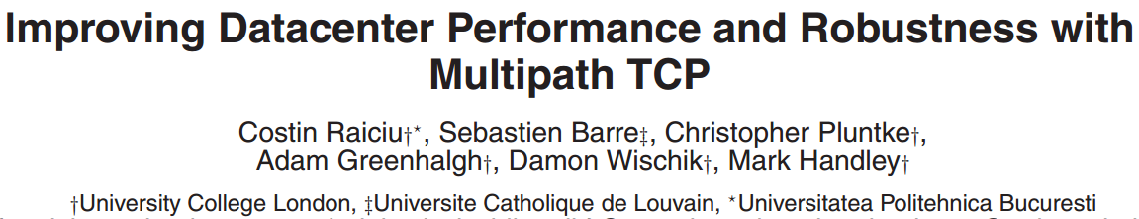
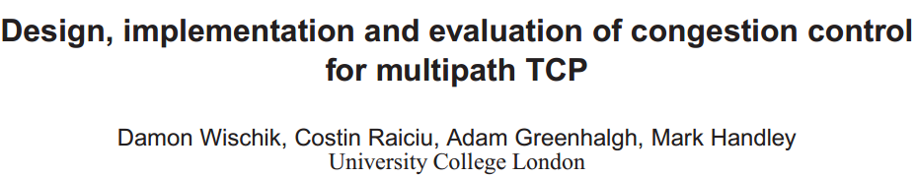
Multi-path Transport
ACM SIGCOMM, 2011
USENIX NSDI, 2011

Slide 67
Multipath TCP
Sub-flows: Implicitly mapping to physical paths
Remain ECMP unchanged!
Sender
Receiver
Data Distribution
SF1
SF1
CWND₁
SF2
SF2
CWND_{total}
CWND₂
SF3
SF3
CWND₃
Multi-path
Congestion Control
Notes:
Before introducing the detailed design of FUSO, I’d like to give some background on multi-path transport.
In multipath transport, a TCP flow is divided into multiple sub-flows.

Slide 68
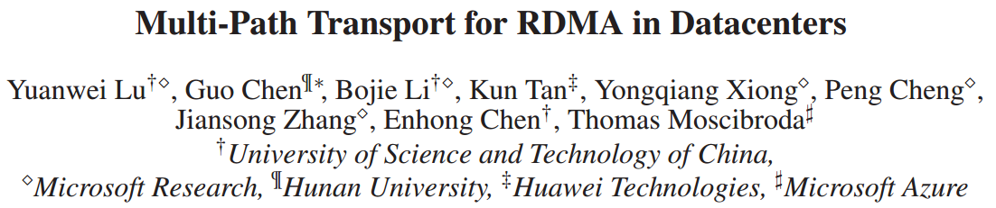
Multi-path Transport for Hardware-based Network Stack
USENIX NSDI, 2018

Slide 69
Other possibilities?
Great freedom and resources!
Notes:
single-entity control
large switch forwarding tables (tens of thousands of L2, L3 entries)
topology is known, controlled by the operator
topologies have lots of links and paths
So watch out for more developments in this space.

Slide 70
Reading materials for group projects
“VL2: A Scalable and Flexible Data Center Network”, SIGOMM 2009
“F2Tree: Rapid Failure Recovery for Routing in Production Data Center Networks”, TON 2017
“CONGA: Distributed Congestion-Aware Load Balancing for Datacenters”, SIGCOMM 2014
“Resilient Datacenter Load Balancing in the Wild”, SIGCOMM 2017
“Let It Flow: Resilient Asymmetric Load Balancing with Flowlet Switching”, NSDI 2017
“Improving Datacenter Performance and Robustness with Multipath TCP”, SIGCOMM 2011
“Design, implementation and evaluation of congestion control for multipath TCP”, NSDI 2011
“Multi-Path Transport for RDMA in Datacenters”, NSDI 2018

Slide 71
Thanks!
陈果 副教授
湖南大学-信息科学与工程学院-计算机与科学系
邮箱：guochen@hnu.edu.cn
个人主页：1989chenguo.github.io

